Slide 1
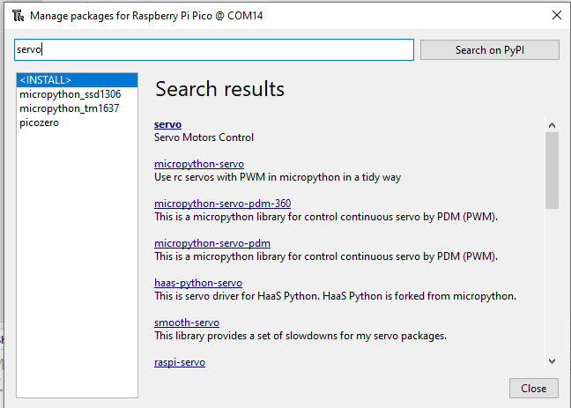
There is an alternative library for the servo motor : micropython-servo
This library allows us to move the servo motor spindle to a specified angle
The servo in picozero can only to be set to min, mid and max. Cannot specify the angle we want.
To install this library use the Tools/Package Manager. Follow instructions below
#sample code
from time import sleep
from servo import Servo
my_servo = Servo(pin_id=1)
my_servo.write(30) #30 degrees
sleep(2.0)
my_servo.write(60) #60 degrees
sleep(2.0)
my_servo.write(90) #90 degrees – mid point
sleep(2)
my_servo.write(0) #extreme left
sleep(2)
my_servo.write(180) #extreme right
Install this one
Documentation PyPI page: https://pypi.org/project/micropython-servo/

Slide 2
Ex 7. Create an automated Carpark Gantry
Material:
Servo Motor (use the new servo library. Follow the sample code example)
Distance Sensor (use the picozero library. Follow the Recipe example)
Refer to attached wiring diagram
Challenge:
Carpark gantry will be raised whenever a vehicle is detected by the distance sensor
Gantry will be raised to 90 degree position of the servo motor for say 3 seconds. After which
It will be lowered to 0 degree position.
Use the example code for the servo motor to find the 0 degree position (gantry closed position)
And the 90 degree position (gantry raised position)

Slide 3
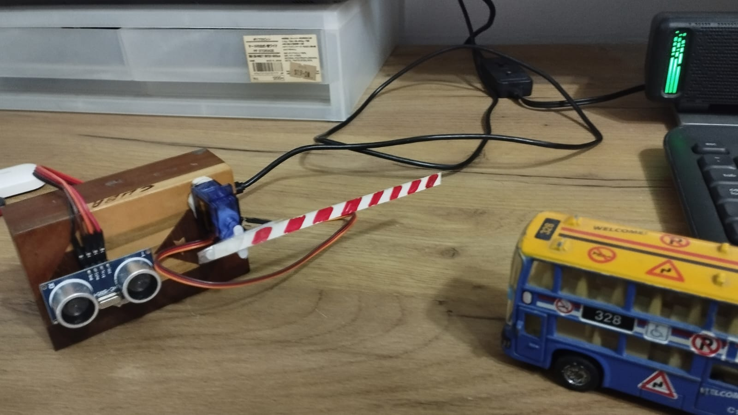

Slide 4
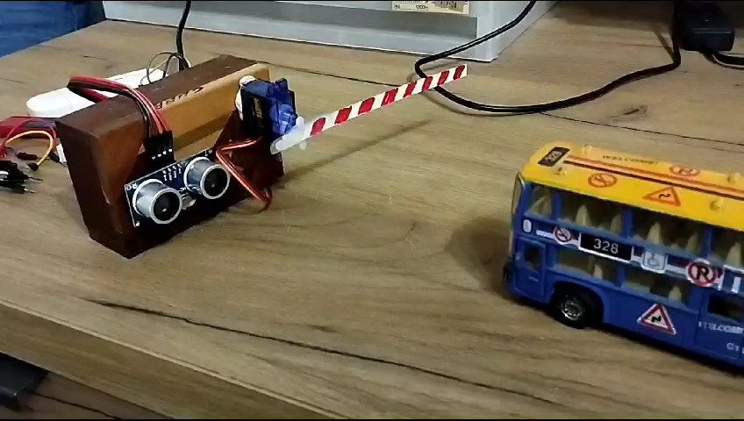

Slide 5
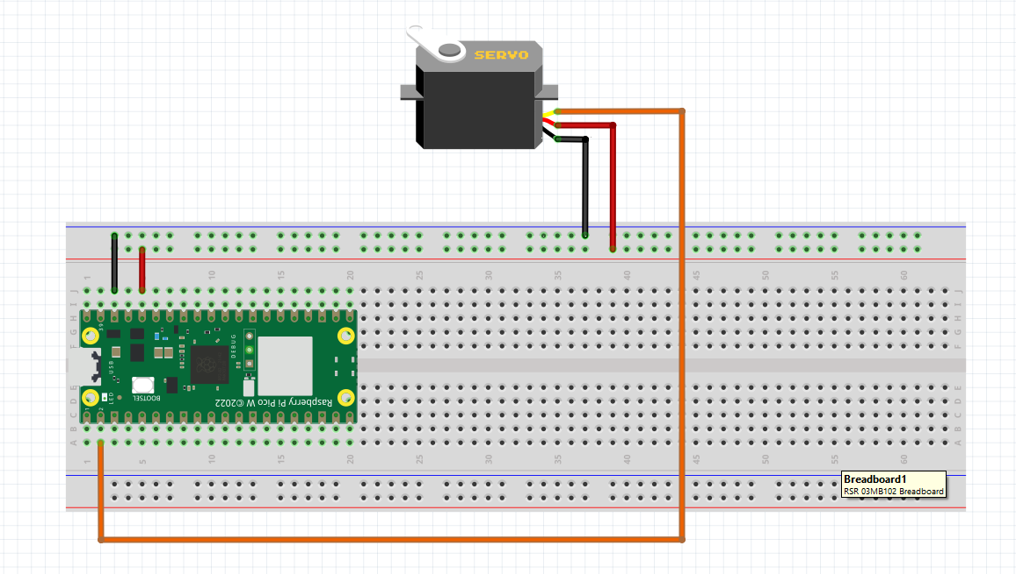
Testing the picozero Library
Servo

Slide 6
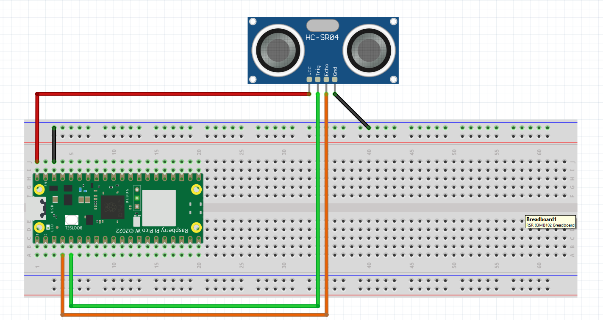
Testing the picozero Library
DistanceSensor
VBUS

